Slide 1
Software Design
Lecture 10

Slide 2
Content
Design Patterns
Creational Patterns
Structural Patterns
Behavioral Patterns
Chain of Responsibility
Command
Observer
State
Strategy

Slide 3
References
Erich Gamma, et.al, Design Patterns: Elements of Reusable Object-Oriented Software, Addison Wesley, 1994, ISBN 0-201-63361-2.
Univ. of Timisoara Course materials

Slide 4
Behavioral patterns
Behavioral patterns are concerned with algorithms and the assignment of responsibilities between objects.
Behavioral patterns describe patterns of communication between classes/objects.
Behavioral class patterns use inheritance to distribute behavior between classes.
Behavioral object patterns use object composition rather than inheritance.

Slide 5
Observer Pattern

Slide 6
Weather Monitoring Application
Humidity
Sensor
Weather
Station
Pulls
Data
displays
Temp
Sensor
Weather Data
Object
Display
Device
Pressure
Sensor

Slide 7
What needs to be done?
WeatherData
getTemperature()
getHumidity()
getPressure()
measurementsChanged()
/*
* Call this method
* whenever measurements are
* Updated
*/
Public void measurementsChanged(){
// your code goes here
}
Update three
different displays

Slide 8
Problem specification
WeatherData class has three getter methods
measurementsChanged() method called whenever there is a change
Three display methods needs to be supported: current conditions, weather statistics and simple forecast
System should be expandable

Slide 9
First cut at implementation
public class WeatherData {
public void measurementsChanged(){
float temp = getTemperature();
float humidity = getHumidity();
float pressure = getPressure();
currentConditionsDisplay.update (temp, humidity, pressure);
statisticsDisplay.update (temp, humidity, pressure);
forecastDisplay.update (temp, humidity, pressure);
}
// other methods
}

Slide 10
First cut at implementation
public class WeatherData {
public void measurementsChanged(){
float temp = getTemperature();
float humidity = getHumidity();
float pressure = getPressure();
currentConditionsDisplay.update (temp, humidity, pressure);
statisticsDisplay.update (temp, humidity, pressure);
forecastDisplay.update (temp, humidity, pressure);
}
// other methods
}
Area of change which can be
Managed better by encapsulation
By coding to concrete implementations
there is no way to add additional display
elements without making code change

Slide 11
Basis for observer pattern
Fashioned after the publish/subscribe model
Works off similar to any subscription model
Buying newspaper
Magazines
List servers
The Observer Pattern defines a one-to-many dependency between objects so that when one object changes state, all of its dependents are notified and updated automatically.

Slide 12
Observer Pattern – Class diagram
<<interface>>
Subject
observers
<<interface>>
Observer
registerObserver()
removeObserver()
notifyObservers()
Update()
subject
ConcreteObserver
ConcreteSubject
registerObserver()
removeObserver()
notifyObservers()
Update()

Slide 13
Observer pattern – power of loose coupling
The only thing that the subject knows about an observer is that it implements an interface
Observers can be added at any time and subject need not be modified to add observers
Subjects and observers can be reused or modified without impacting the other [as long as they honor the interface commitments]

Slide 14
Observer Pattern – Weather data
<<interface>>
Observer
observers
<<interface>>
DisplayElement
<<interface>>
Subject
update()
registerObserver()
removeObserver()
notifyObservers()
display()
subject
CurrentConditionsDisplay
StatisticsDisplay
WeatherData
update()
display()
update()
display()
registerObserver()
removeObserver()
notifyObservers()
getTemperature()
getPressure()
measurementsChanged()
ForecastDisplay
update()
display()

Slide 15
Weather data interfaces
public interface Subject {
public void registerObserver(Observer o);
public void removeObserver(Observer o);
public void notifyObservers();
}
public interface Observer {
public void update(float temp, float humidity, float pressure);
}
public interface DisplayElement {
public void display();
}

Slide 16
Implementing subject interface
public class WeatherData implements Subject {
private ArrayList observers;
private float temperature;
private float humidity;
private float pressure;
public WeatherData() {
observers = new ArrayList();
}

Slide 17
Register and unregister
public void registerObserver(Observer o) {
observers.add(o);
}
public void removeObserver(Observer o) {
int i = observers.indexOf(o);
if (i >= 0) {
observers.remove(i);
}
}

Slide 18
Notify methods
public void notifyObservers() {
for (int i=0; i<observers.size();i++)
{
Observer observer = (Observer)observers.get(i);
observer.update(temperature, humidity, pressure);
}
}
public void measurementsChanged() {
notifyObservers()
}

Slide 19
Observer pattern
More analysis

Slide 20
Push or pull
The notification approach used so far pushes all the state to all the observers
One can also just send a notification that some thing has changed and let the observers pull the state information
Java observer pattern support has built in support for both push and pull in notification
java.util.Observable
java.util.Observer

Slide 21
Java Observer Pattern – Weather data
<<interface>>
Observer
observers
<<interface>>
DisplayElement
Observable
update()
addObserver()
deleteObserver()
notifyObservers()
setChanged()
Observable is a class
And not an interface
display()
subject
CurrentConditionsDisplay
StatisticsDisplay
WeatherData
update()
display()
update()
display()
registerObserver()
removeObserver()
notifyObservers()
getTemperature()
getPressure()
measurementsChanged()
ForecastDisplay
update()
display()

Slide 22
Problems with Java implementation
Observable is a class
You have to subclass it
You cannot add observable behavior to an existing class that already extends another superclass
You have to program to an implementation – not interface
Observable protects crucial methods
Methods such as setChanged() are protected and not accessible unless one subclasses Observable.
You cannot favor composition over inheritance.
You may have to roll your own observer interface if Java utilities don’t work for your application

Slide 23
Changing the "Guts" of an Object ...
Optimize
use an alternative algorithm to implement behavior (Strategy)
Alter
change behavior when object's state changes (State)
Control
"shield" the implementation from direct access (Proxy)
Decouple
let abstraction and implementation vary independently (Bridge)

Slide 24
Strategy Pattern

Slide 25
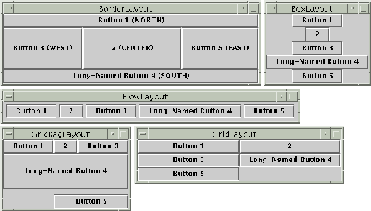
Java Layout Managers
GUI container classes in Java
frames, dialogs, applets (top-level)
panels (intermediate)
Each container class has a layout manager
determine the size and position of components
20 types of layouts
~40 container-types
imagine to combine them
freely by inheritance
Consider also sorting...
open-ended number of
sorting criteria

Slide 26
Basic Aspects
Intent
Define a family of algorithms, encapsulate each one, and make them interchangeable
Let the algorithm vary independently from clients that use it
Applicability
You need different variants of an algorithm
An algorithm uses data that clients shouldn't know about
avoid exposing complex, algorithm-specific data structures
Many related classes differ only in their behavior
configure a class with a particular behavior

Slide 27
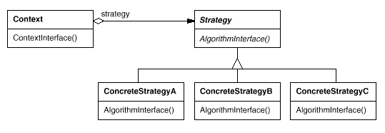
Structure

Slide 28
Participants
Strategy
declares an interface common to all supported algorithms.
Context uses this interface to call the algorithm defined by a ConcreteStrategy
ConcreteStrategy
implements the algorithm using the Strategy interface
Context
configured with a ConcreteStrategy object
may define an interface that lets Strategy objects to access its data

Slide 29
Consequences
Families of related algorithms
usually provide different implementations of the same behavior
choice decided by time vs. space trade-offs
Alternative to subclassing
see examples with layout managers
We still subclass the strategies…
Eliminates conditional statements
many conditional statements → "invitation" to apply Strategy!

Slide 30
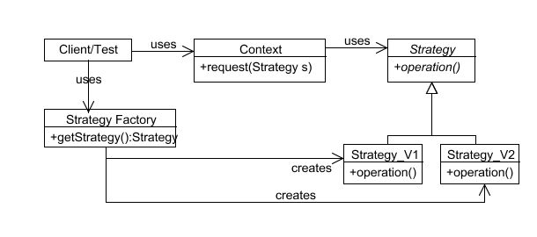
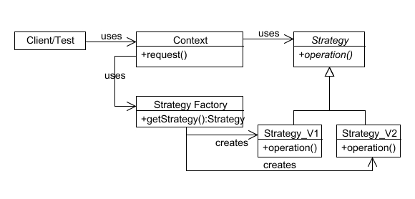
Issues
Who chooses
the strategy?
a. client
b. context

Slide 31
Implementation
How does data flow between Context and Strategies?
Approach 1: take data to the strategy
decoupled, but might be inefficient
Approach 2: pass Context itself and let strategies take data
Context must provide a more comprehensive access to its data
thus, more coupled
In Java strategy hierarchy might be inner classes
Making Strategy object optional
provide Context with default behavior
if default used no need to create Strategy object
don't have to deal with Strategy unless you don't like the default behavior

Slide 32
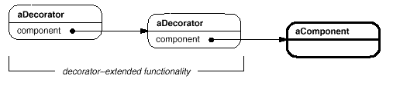
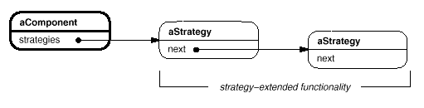
Decorator vs. Strategy

Slide 33
State Pattern

Slide 34
Example: SPOP
SPOP = Simple Post Office Protocol
used to download emails from server
SPOP supports the following commands:
USER <username>
PASS <password>
LIST
RETR <message number>
QUIT
USER & PASS commands
USER with a username must come first
PASS with a password or QUIT must come after USER
If the username and password are valid, the user can use other commands

Slide 35
SPOP (contd.)
LIST command
Arguments: a message-number (optional)
Returns: size of message in octets
if message number, returns the size of that message
otherwise return size of all mail messages in the mail-box
RETR command
Arguments: a message number
Returns: the mail message indicated by that number
QUIT command
Arguments: none
updates mailbox to reflect transactions taken during the transaction state, the logs user out
if session ends by any method except the QUIT command, the updates are not done

Slide 36
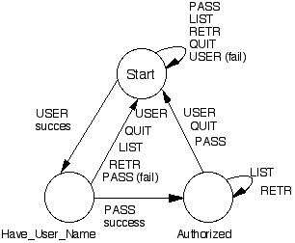
SPOP States

Slide 37
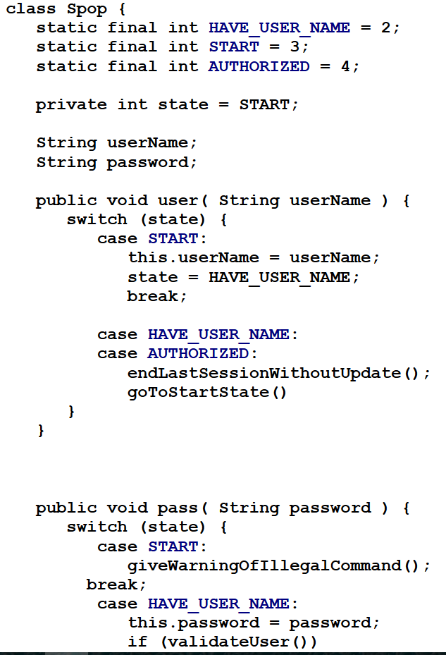
The "Dear, Old" Switches in Action
...as you see in this code
long functions
complex switches
same switches occur repeatedly in different functions
Think about adding a new state to the protocol...
changes all the code
not Open-Closed
Why?
object's behavior depends on its state

Slide 38
Basic Aspects of State Pattern
Intent
allow an object to alter its behavior when its internal state changes
object will appear to change its class
Applicability
object's behavior depends on its state
it must change behavior at run-time depending on that state
operations with multipart conditional statements depending on the object's state
state represented by one or more enumerated constants
several operations with the same (or similar) conditional structure

Slide 39
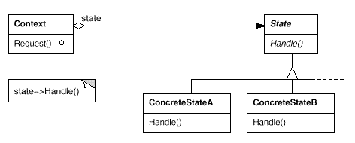
Structure

Slide 40
Participants
Context
defines the interface of interest for clients
maintains an instance of ConcreteState subclass
State
defines an interface for encapsulating the behavior associated with a particular state of the Context
ConcreteState
each subclass implements a behavior associated with a state of the Context

Slide 41
Collaborations
Context delegates state-specific requests to the State objects
the Context may pass itself to the State object
if the State needs to access it in order to accomplish the request
State transitions are managed either by Context or by State
see discussion on the coming slides
Clients interact exclusively with Context
but they might configure contexts with states
e.g initial state

Slide 42
Consequences
Localizes state-specific behavior and partitions behavior for different states
Put all behavior associated with a state in a state-object
Easy to add new states and transitions
context becomes O-C
Behavior spread among several State subclasses
number of classes increases, less compact than a single class
good if many states...
Makes state transitions explicit
Not only a change of an internal value
States receive a full-object status!
Protects Context from inconsistent internal states

Slide 43
Applying State to SPOP
class SPop {
private SPopState state = new Start();
public void user( String userName ) {
state = state.user( userName );
}
public void pass( String password ) {
state = state.pass( password );
}
public void list( int messageNumber ) {
state = state.list( massageNumber );
}
// . . .
}

Slide 44
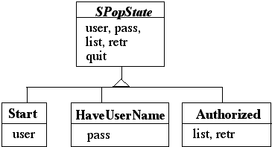
SPOP States

Slide 45
How much State in the State?
Let's identify the roles...
SPop is the Context
SPopState is the abstract State
Start, HaveUserName are ConcreteStates
All the state and real behavior is in SPopState and subclasses
this is an extreme example
In general Context has data and methods
besides State & State methods
this data will not change states
Only some aspects of the Context will alter its behavior

Slide 46
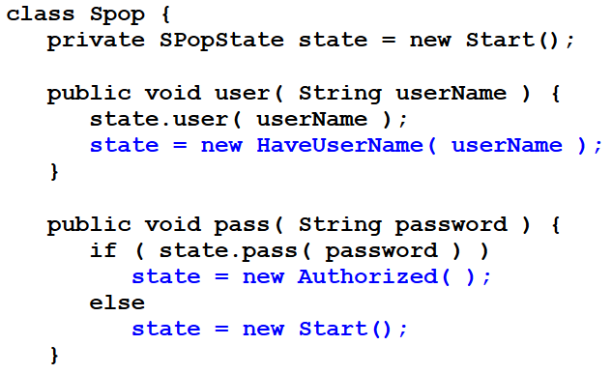
Who Defines the State transition?
The Context if ...
...states will be reused in different state machines with different transitions
... the criteria for changing states are fixed

Slide 47
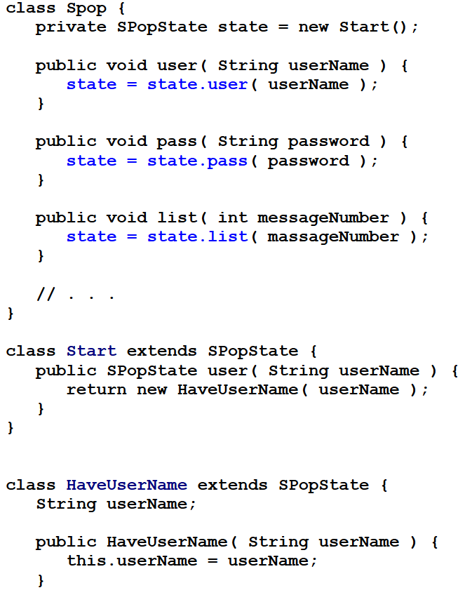
The States
More flexible to let State subclasses specify the next state
As seen before

Slide 48
State versus Strategy
Rate of Change
Strategy
Context object usually contains one of several possible ConcreteStrategy objects
State
Context object often changes its ConcreteState object over its lifetime
Visibility of Change
Strategy
All ConcreteStrategy do the same thing, but differently
Clients do not see any difference in behavior in the Context
State
ConcreteState acts differently
Clients see different behavior in the Context

Slide 49
Command Pattern

Slide 50
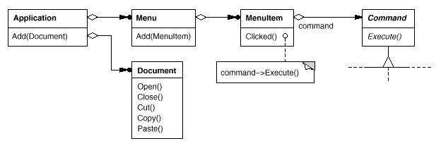
Menu Items Use Commands

Slide 51
Basic Aspects
Intent
Encapsulate requests as objects, letting you to:
parameterize clients with different requests
queue or log requests
support undoable operations
Applicability
Parameterize objects
replacement for callbacks
Specify, queue, and execute requests at different times
Support undo
recover from crashes → needs undo operations in interface
Support for logging changes
recover from crashes → needs load/store operations in interface
Model transactions
structure systems around high-level operations built on primitive ones
common interface ⇒ invoke all transaction same way

Slide 52
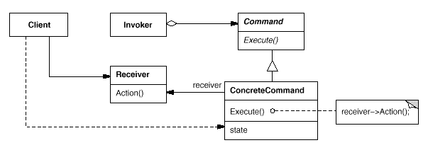
Structure
Holds command
set
create
Transforms: concreteReceiver.action() in command.execute()

Slide 53
Participants
Command
declares the interface for executing the operation
ConcreteCommand
binds a request with a concrete action
Invoker
asks the command to carry out the request
Receiver
knows how to perform the operations associated with carrying out a request.
Client
creates a ConcreteCommand and sets its receiver

Slide 54
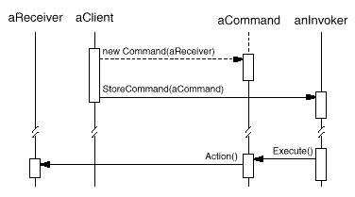
Collaborations
Client → ConcreteCommand
creates and specifies receiver
Invoker → ConcreteCommand
ConcreteCommand → Receiver

Slide 55
Consequences
Decouples Invoker from Receiver
Commands are first-class objects
can be manipulated and extended
Composite Commands
see also Composite pattern
Easy to add new commands
Invoker does not change
it is Open-Closed
Potential for an excessive number of command classes

Slide 56
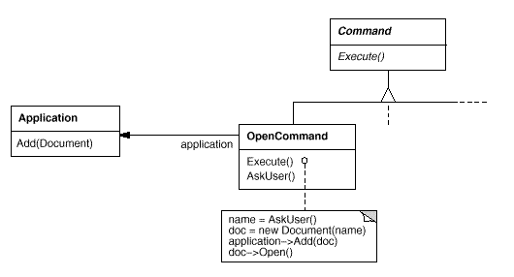
Example: Open Document

Slide 57
Intelligence of Command objects
"Dumb"
delegate everything to Receiver
used just to decouple Sender from Receiver
"Genius"
does everything itself without delegating at all
useful if no receiver exists
let ConcreteCommand be independent of further classes
"Smart"
find receiver dynamically

Slide 58
Undoable Commands
Need to store additional state to reverse execution
receiver object
parameters of the operation performed on receiver
original values in receiver that may change due to request
receiver must provide operations that makes possible for command object to return it to its prior state
History list
Sequence of commands that have been executed
used as LIFO with reverse-execution ⇒ undo
used as FIFO with execution ⇒ redo
Commands may need to be copied
when state of commands change by execution

Slide 59
C++: Commands and Templates
Avoids subclassing for every kind of action and receiver
Usable for simple commands
don't require arguments in receiver
are not undoable
Works only for simple commands!
if action needs parameters or command must keep state use a Command subclass!

Slide 60
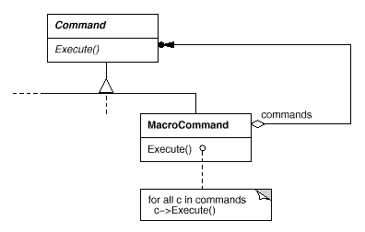
Composed Commands

Slide 61
Chain of Responsibility Pattern

Slide 62
Basic Aspects
Intent
Decouple sender of request from its receiver
by giving more than one object a chance to handle the request
Put receivers in a chain and pass the request along the chain
until an object handles it
Motivation
context-sensitive help
a help request is handled by one of several UI objects
Which one?
depends on the context
The object that initiates the request does not know the object that will eventually provide the help

Slide 63
When to Use?
Applicability
more than one object may handle a request
and handler isn't known a priori
set of objects that can handle the request should be dynamically specifiable
send a request to several objects without specifying the receiver

Slide 64
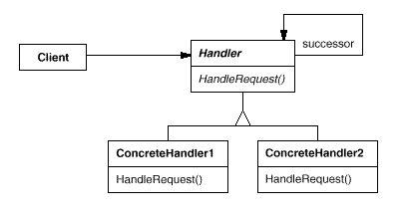
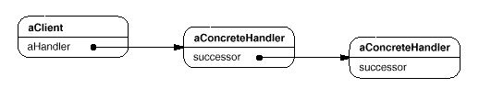
Structure

Slide 65
Participants & Collaborations
Handler
defines the interface for handling requests
may implement the successor link
ConcreteHandler
either handles the request it is responsible for ...
... or it forwards the request to its successor
Client
initiates the request to a ConcreteHandler object in the chain

Slide 66
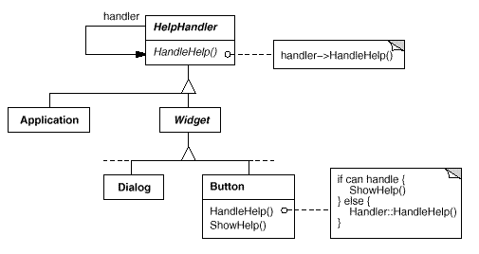
The Context-Help System

Slide 67
Consequences
Reduced Coupling
frees the client (sender) from knowing who will handle its request
sender and receiver don't know each other
instead of sender knowing all potential receivers, just keep a single reference to next handler in chain.
simplify object interconnections
Flexibility in assigning responsibilities to objects
responsibilities can be added or changed
chain can be modified at run-time
Requests can go unhandled
chain may be configured improperly

Slide 68
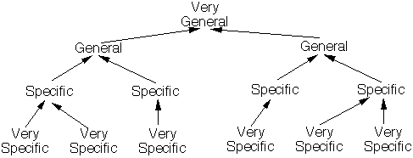
How to Design Chains of Commands?
Like the military
a request is made
it goes up the chain of command until someone has the authority to answer the request

Slide 69
Implementing the Successor Chain
Define new link
Give each handler a link to its successor
Use existing links
concrete handlers may already have pointers to their successors
parent references in a part-whole hierarchy
can define a part's successor
spares work and space ...
... but it must reflect the chain of responsibilities that is needed

Slide 70
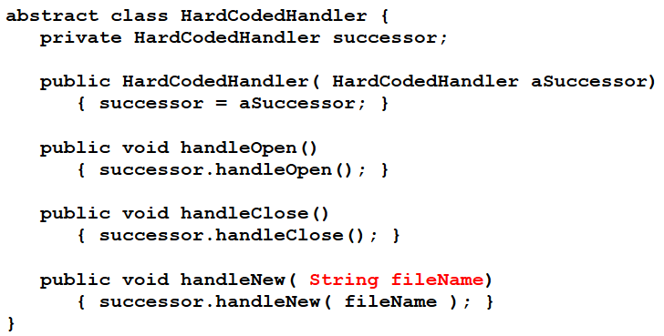
Representing Multiple Requests using One Chain
Each request is hard-coded
convenient and safe
not flexible (limited to the fixed set of requests defined by handler)

Slide 71
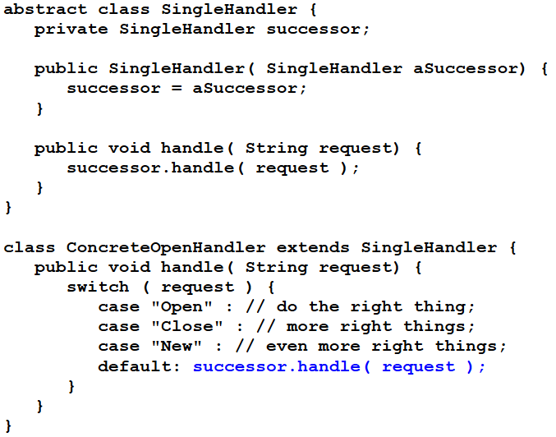
Unique handler with parameters
more flexible
but it requires conditional statements for dispatching request
less type-safe to pass parameters

Slide 72
Decorator vs. Chain of Responsibility
Chain of Responsibility
Decorator
Comparable to “event-oriented” architecture
Comparable to layered architecture (layers of an onion)
The "filter" objects are of equal rank
A "core" object is assumed, all "layer" objects are optional
User views the chain as a "launch and leave" pipeline
User views the decorated object as an enhanced object
A request is routinely forwarded until a single filter object handles it.
many (or all) filter objects could contrib. to each request's handling.
A layer object always performs pre or post processing as the request is delegated.
All the handlers are peers (like nodes in a linked list) – "end of list" condition handling is required.
All the layer objects ultimately delegate to a single core object - "end of list" condition handling is not required.

Slide 73
Next time
Quality attributes
Representation
Strategies
Review for the final exam

